Slide 1
Distributed Database Systems
By
Syed Bakhtawar Shah Abid
Assistant Professor
Department of Computer Science

Slide 2
DISTRIBUTED DATABASE SYSTEM
A distributed database system is characterized by the distribution of the system components of hardware ,control and data.
A distributed system is a collection of independent computers interconnected via point-to-point communication lines.

Slide 3
DISTRIBUTED DATABASE
A distributed database (DDB) is a collection of multiple, logically interrelated databases distributed over a computer network.
A distributed database management system (D–DBMS) is the software that manages the DDB and provides an access mechanism that makes this distribution transparent to the users.
Distributed database system (DDBS) = DDB + D–DBMS

Slide 4
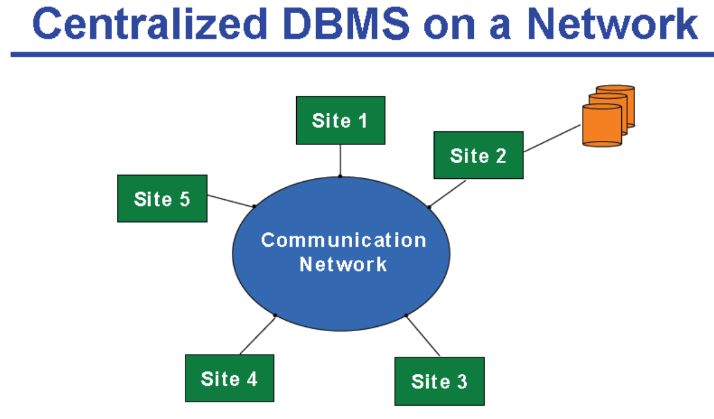
DISTRIBUTED DATABASE

Slide 5
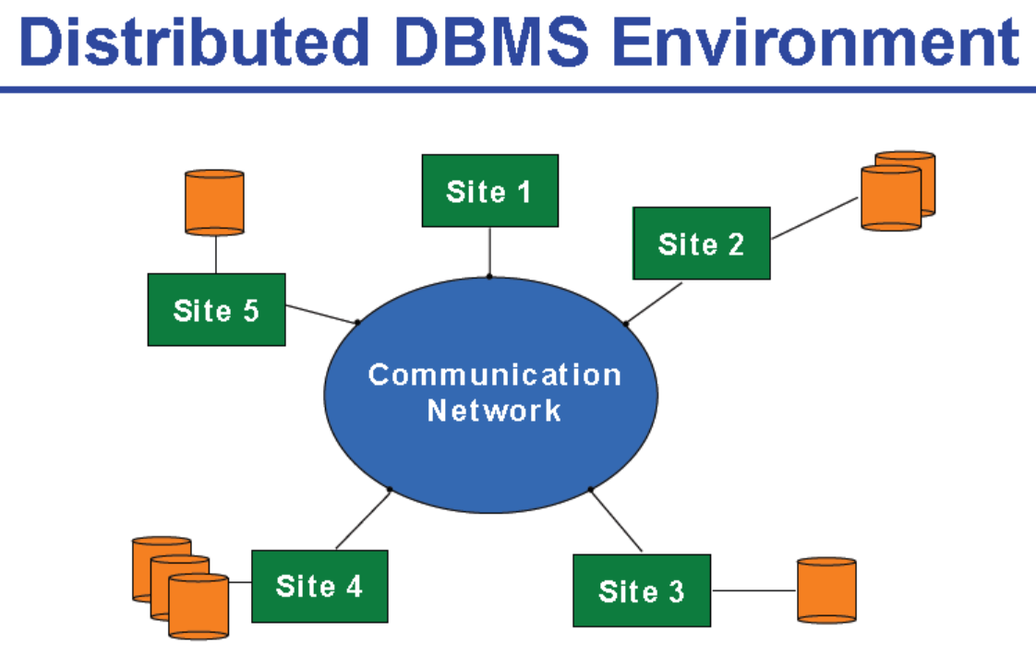
DISTRIBUTED DATABASE

Slide 6
Distributed Data Processing
Distributed data processing allows multiple computers to be working among multiple geographically separate sites where local computers handle local processing needs

Slide 7
Distributed Data Processing
The Distributed Systems is the opposite to the centralized system:
Computers installed at different sites
Each of them performing independent data processing
Each computer is specialized to perform a range of activities (marketing, promotion….)
More redundancy
More autonomy

Slide 8
Distributed Data Why is DDP Increasing?
Dramatically reduced hardware costs
Increased desktop power
Improved user interfaces
Ability to share data across multiple servers

Slide 9
REASONS FOR DDP
Need for new applications
On large centralized systems, development can take years
On small distributed systems, development can be component-based and very fast
Need for short response time
Centralized system result is contention among users and processes
Distributed systems provide dedicated resources

Slide 10
Drawbacks of DDP
More components and dependence on communication means more points of failure
Difficulties in failure diagnosis
Incompatibility of components
Incompabilityof data
More complex management and conrol
Difficulty controlling information resources
Duplication of effort

Slide 11
Advantages of Distributed Database
Increased reliability/availability
Local control over data
Modular growth
Lower communication costs
Faster response for certain queries

Slide 12
Disadvantages of Distributed Database
Software cost and complexity
Processing overhead
Data integrity exposure
Slower response for certain queries

